Slide 1
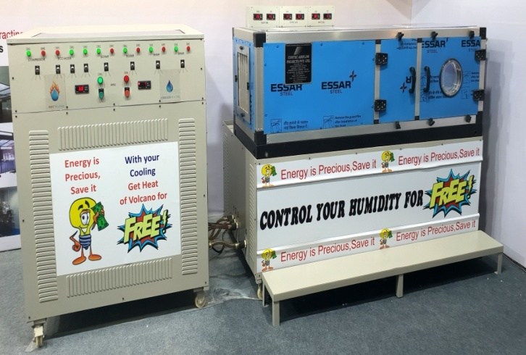
Inline with our companies commitment for Go green technology initiative
we have introduced Energy Multiplier ( EM ) series of Equipments.
EM series Dehumidifier
EM series chiller
EM series TFA
EM SERIES DRYING CHAMBER
EM series chiller

Slide 2
All new EM series equipments
Works on
Seamless Ultracool condensation
Works on
Switch over Energy Multiplier technology
Enables
Close tolerance temperature & RH control
All new EM series equipments comes with a host of exciting features
PLC controlled WIFI enabled
Independent standalone machine
No surplus utility required

Slide 3
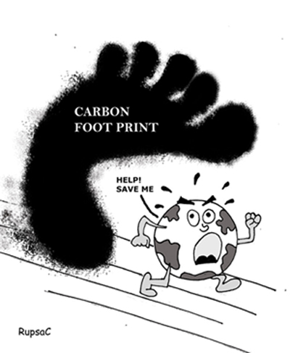
What is carbon footprint?
A carbon footprint is measure of the impact our activities have on the environment. It relates to greenhouse gases produced in our day to day lives by burning fossil fuels for electricity, heating, etc.
1kW x 8 hours/day x 300 days is equal to 2400kWh x 0.85(emission factor) i.e. 2040 kg of CO2.
Calculate your carbon footprint for every kW of power saved.
Considering electric power tariff of 8 rs/ kWhr. By saving 1 kW, annually you will save rs 8 x 2400 kWh i.e. 19200 rupees.
Be a global responsible citizen and
stop global warming

Slide 4
“ENERGY MULTIPLIER CHILLER”
The Super Energy Saver

Slide 5
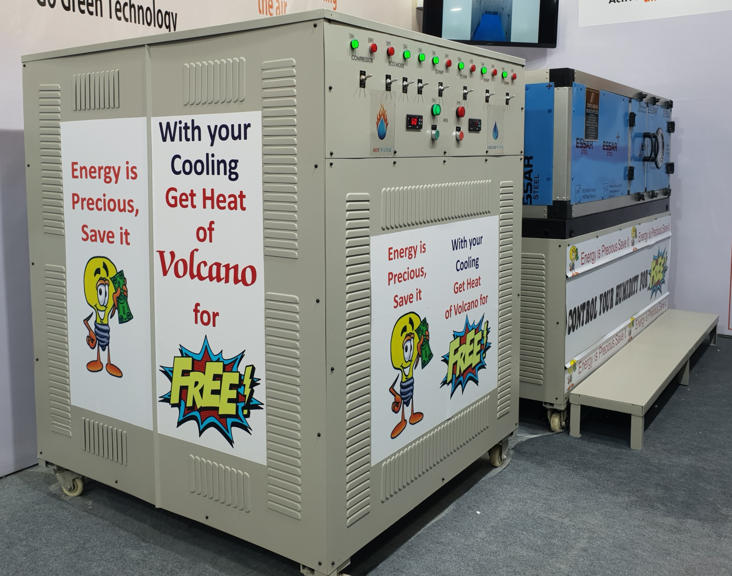

Slide 6
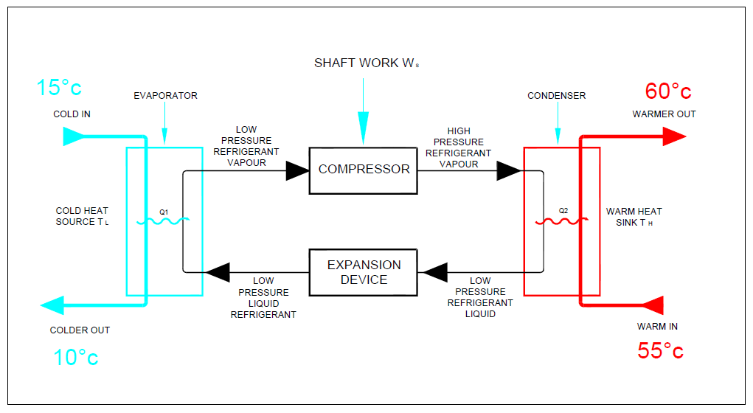
Basic Refrigeration Cycle

Slide 7
Cooling & Heating are two sides of same heat transactions.
In energy multiplier both side of energy transaction are put into use thereby saving big amount of energy.

Slide 8
For every 1 KW of power
Consumed
GET
3.5 KW of Cooling
&
4.5 KW of Heating
together in one cycle

Slide 9
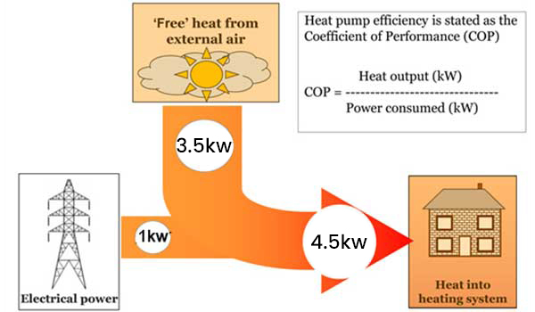

Slide 10
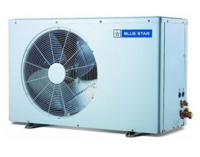
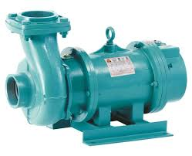
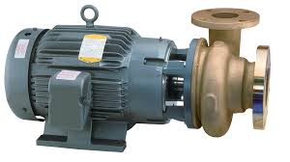
ENERGY MULTIPLIER SLD
Detail View B
PLC based Control Unit
Refrigerant piping
EM 01
24kW
Hot water piping
Hot water piping
EM 02
24KW
Refrigerant piping
Hot water piping
PRIMARY PUMPS
Hot water piping
HOT SIDE
COLD SIDE
EM 03
24KW
Hot water piping
Refrigerant piping
HOT WATER TANK
Hot water piping
EM 04
24KW
Refrigerant piping
Hot water piping
AHU - 01
EM – Energy Multiplier
SECONDARY PUMPS
AHU - 02
Hot water piping
AHU – N
Detail View A

Slide 11
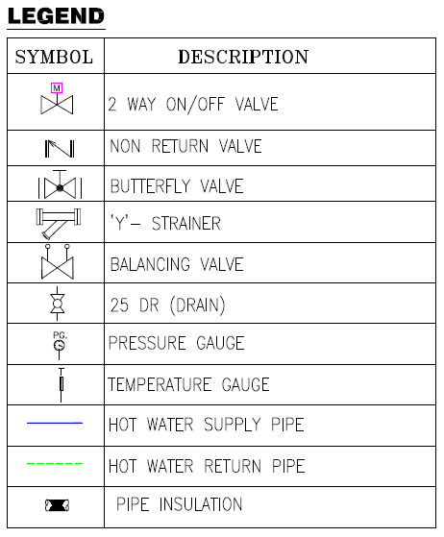
AHU P&I diagram hot water piping
DETAIL VIEW A

Slide 12
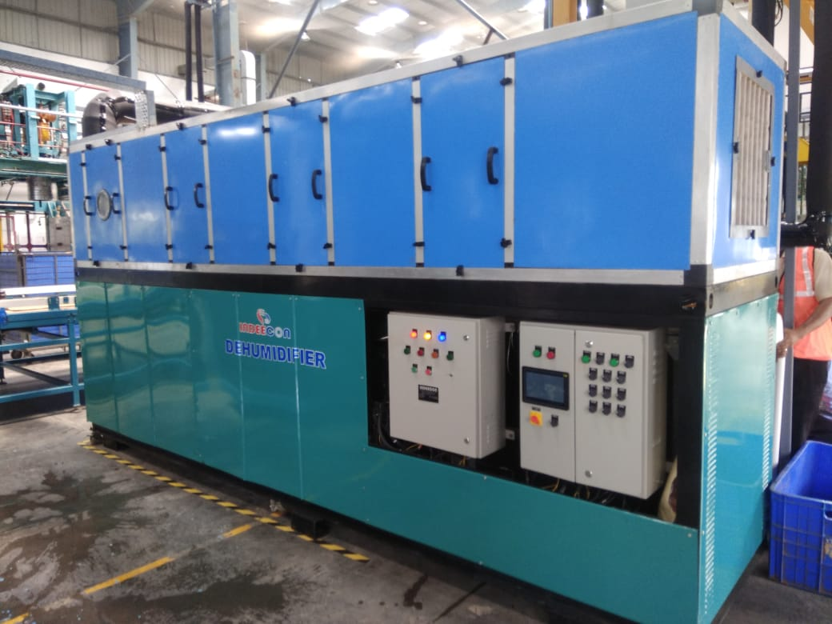
Sr No. | Description | Value
1 | Application | 100% fresh air
2 | CFM | 1500
3 | Total TR | 19.2
3a | CHW TR | 14
3b | CDU TR | 5.2
4 | Heating KW | 38.25
CHW – Chilled water , CDU –Condensing unit,

Slide 13
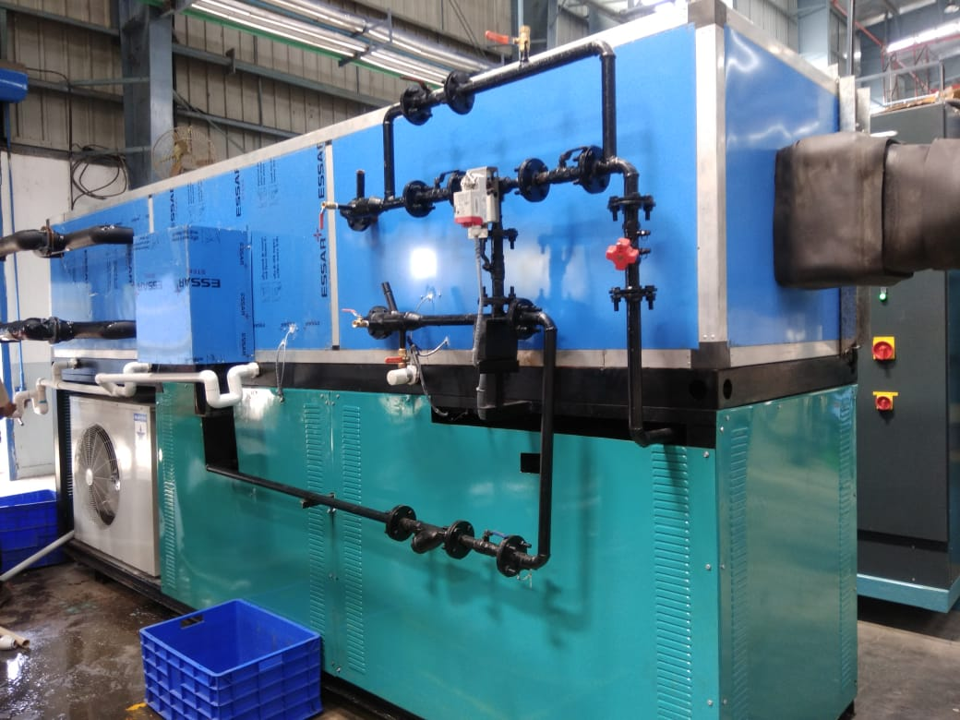

Slide 14
Satisfactory performance certificate by Client

Slide 15
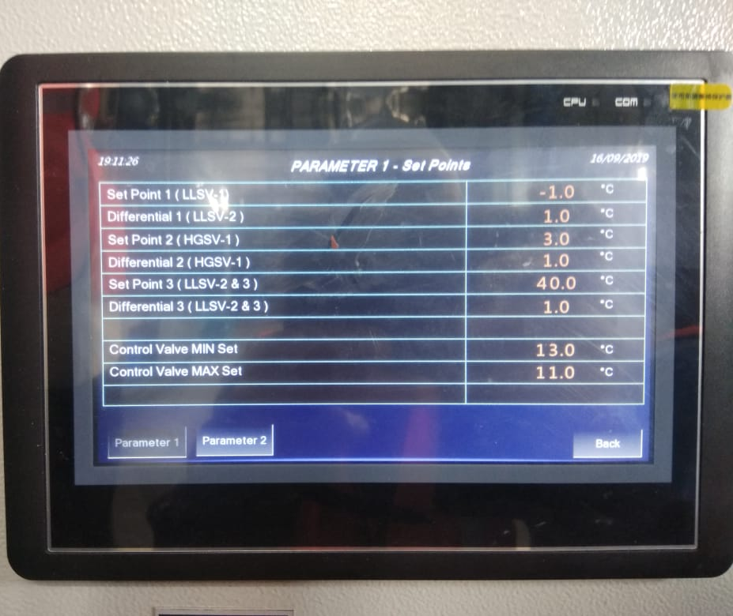
PLC DISPLAY

Slide 16
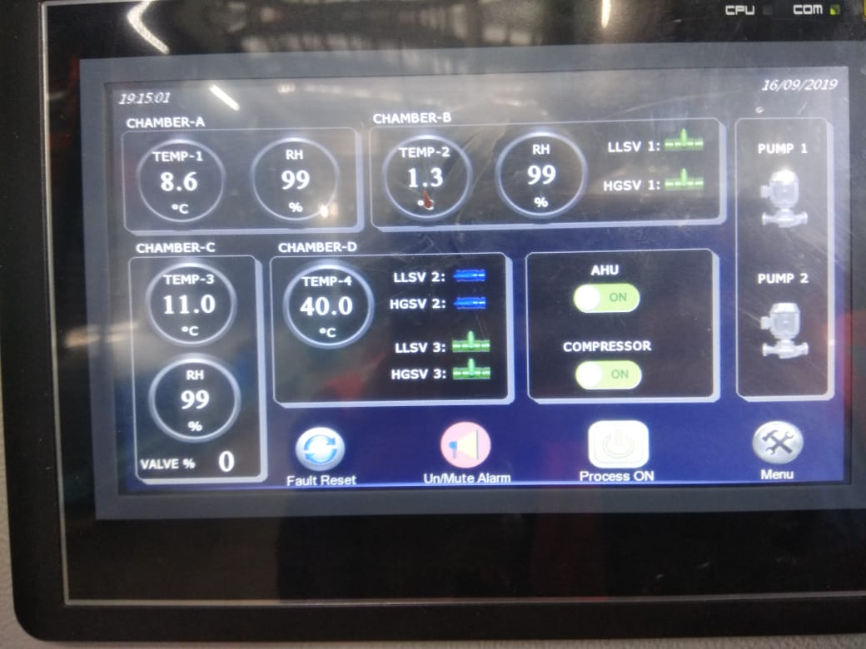
PLC DISPLAY

Slide 18
CASE STUDY
Client Name : Eris Lifescience , Kanpur
No of AHU’s : 13 Nos.
Monsoon Reheat Required : 94 Kw.
Contec’s Recommendation: Replacement of 94Kw of electrical heaters with hot water generated free of cost.
Additional Cost incurred : Rs. 11,15,779.
Annual Saving in rupees : Rs. 16,41,564.
Payback period in months : 8 months

Slide 19
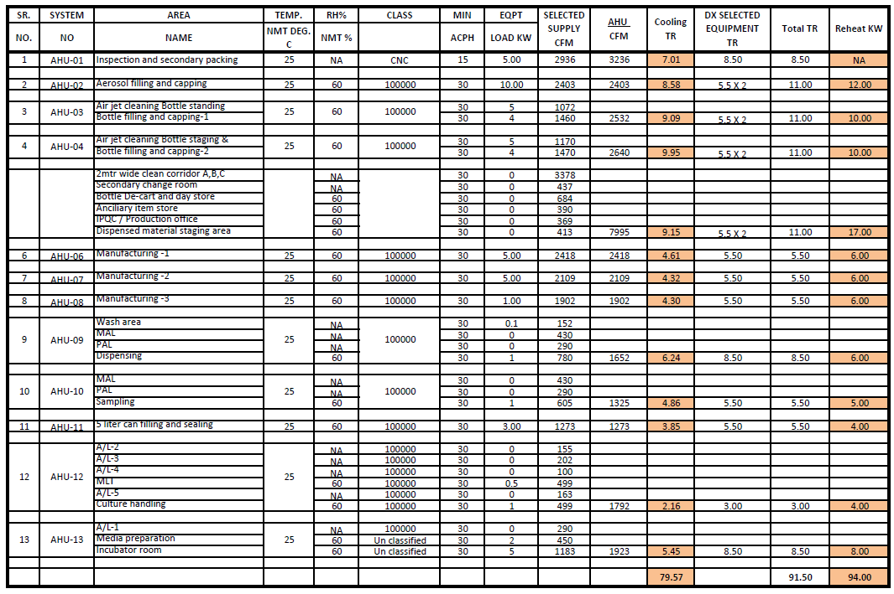
BASIS OF DESIGN

Slide 20
POWER COMSUMPTION

Slide 21
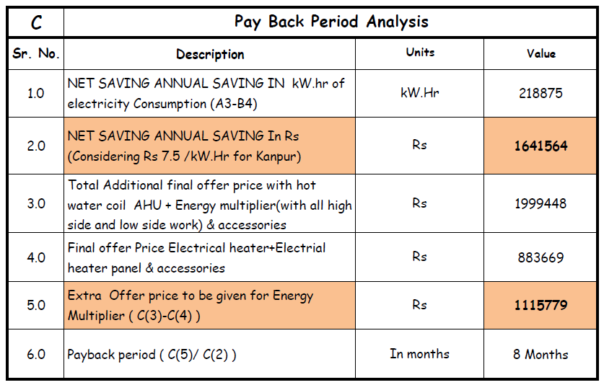
PAYBACK PERIOD ANALYSIS

