Slide 1
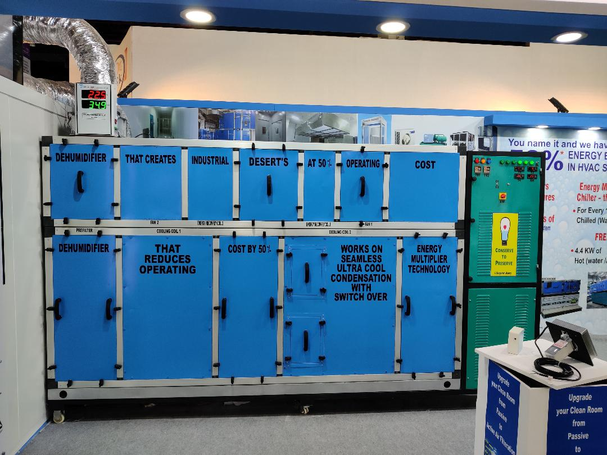
Inline with our companies commitment for Go green technology initiative
we have introduced Energy Multiplier ( EM ) series of Equipments.
EM series Dehumidifier
EM series chiller
EM series TFA
EM SERIES DRYING CHAMBER
EM SERIES DRYING CHAMBER
EM series Dehumidifier

Slide 2
All new EM series equipments
Works on
Seamless Ultracool condensation
Works on
Switch over Energy Multiplier technology
Enables
Close tolerance temperature & RH control
All new EM series equipments comes with a host of exciting features
PLC controlled WIFI enabled
Independent standalone machine
No surplus utility required

Slide 3
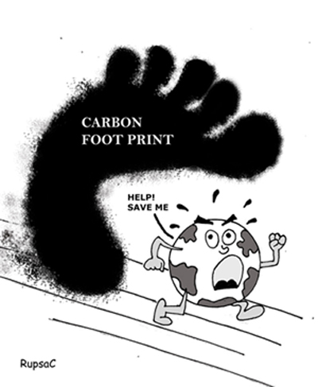
What is carbon footprint?
A carbon footprint is measure of the impact our activities have on the environment. It relates to greenhouse gases produced in our day to day lives by burning fossil fuels for electricity, heating, etc.
1kW x 8 hours/day x 300 days is equal to 2400kWh x 0.85(emission factor) i.e. 2040 kg of CO2.
Calculate your carbon footprint for every kW of power saved.
Considering electric power tariff of 8 rs/ kWhr. By saving 1 kW, annually you will save rs 8 x 2400 kWh i.e. 19200 rupees.
Be a global responsible citizen and
stop global warming

Slide 4
“ENERGY MULTIPLIER DEHUMIDIFIER” THE SUPER ENERGY SAVER

Slide 6
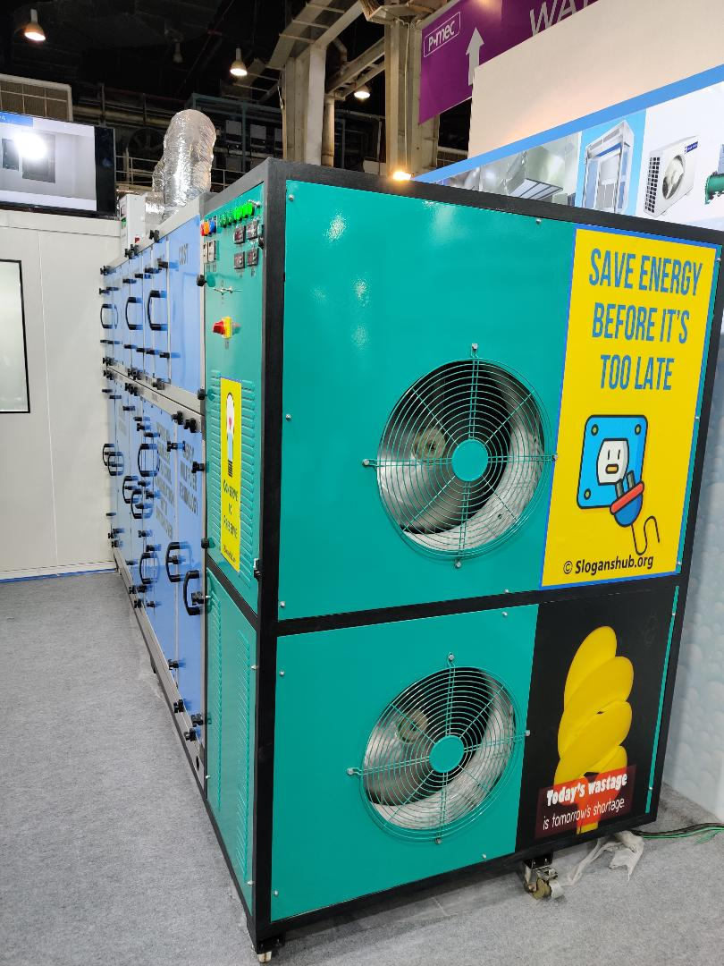

Slide 7
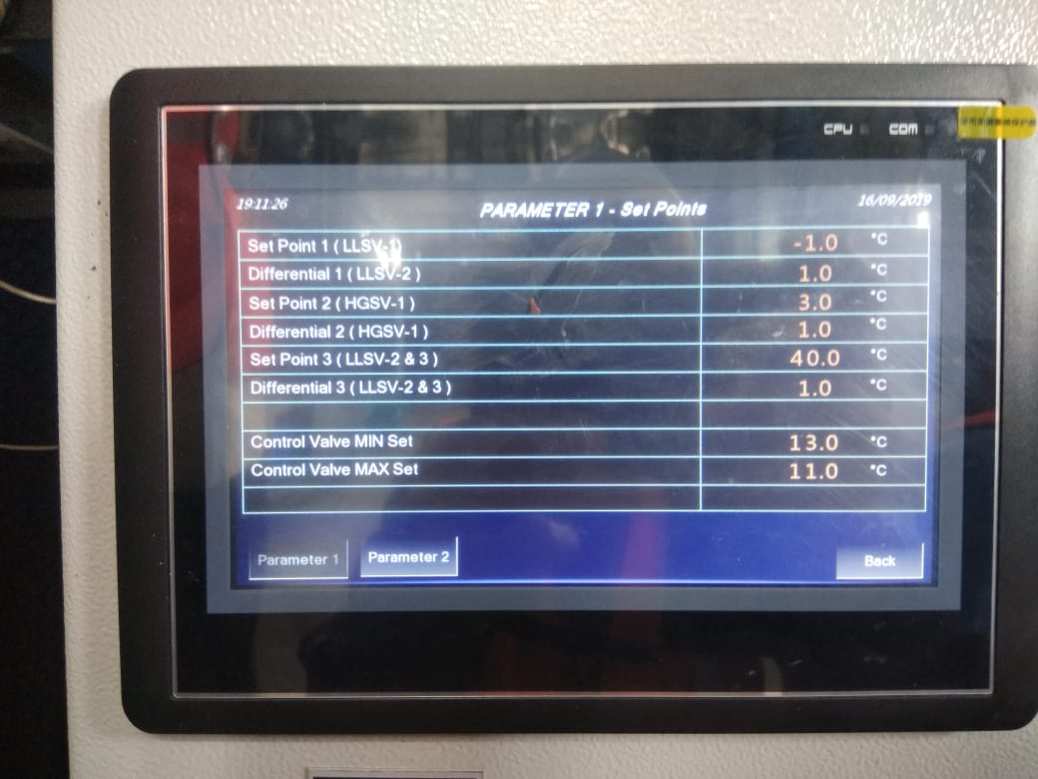
PLC DISPLAY

Slide 8
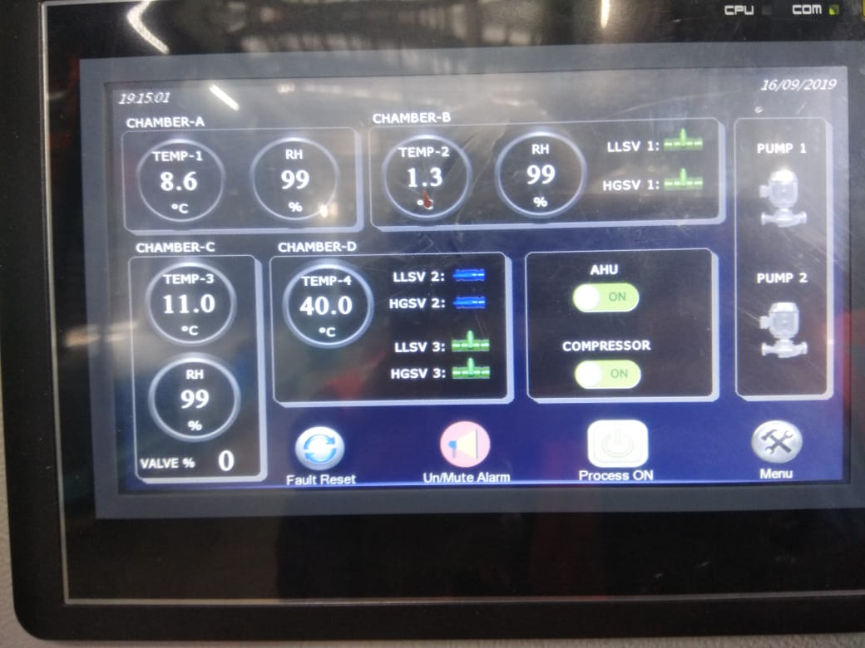
PLC DISPLAY

Slide 9
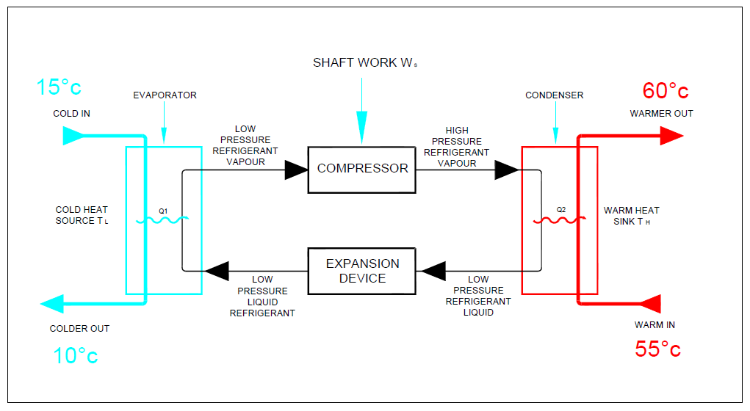
Basic Refrigeration Cycle

Slide 10
Cooling & Heating are two sides of same heat transactions.
In energy multiplier both side of energy transaction are put into use thereby saving big amount of energy.

Slide 11
For every 1 KW of power
Consumed
GET
3.5 KW of Cooling
&
4.5 KW of Heating
together in one cycle

Slide 12
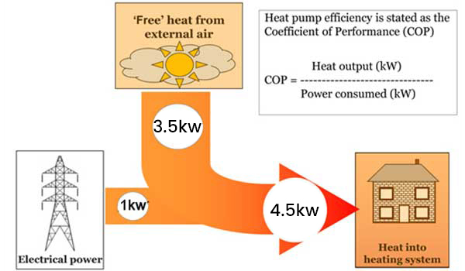

Slide 13
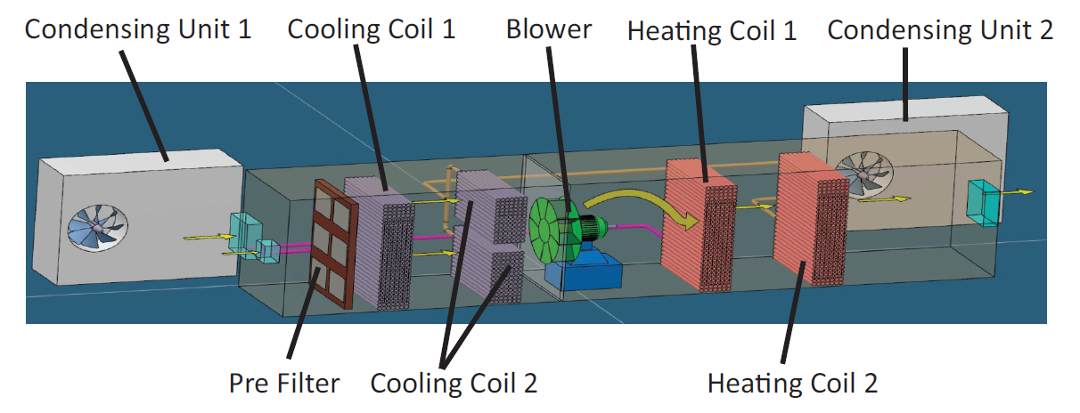
EM series Dehumidifier
THERE ARE FOUR STAGES INVOLVED IN THIS PRINCIPLE
STAGE 1 Cools the fresh air or return air close to 0°C or as required by design.
Cooling condenses the moisture in air.
STAGE 2 Ultra cool's the stage 1 air below 0°C or as required Dew Point by design. Ultra cooling further condenses the moisture in the air .
STAGE 3 Reheats the air through condenser heat recovery module of stage 1.
STAGE 4 Reheats the air through condenser heat recovery module of stage 2 to maintain room temperature.

Slide 15
CASE STUDY
Client Name :Spectrum
No of AHU’s : 1 Nos.
Power consumed by conventional dessicant wheel dehumidifier : 55 kW.
Power consumed by Contec EM series dehumidifier : 28 kW.
Additional Cost incurred : Rs. 0.
Annual Saving in rupees : Rs. 986150.
Payback period in months : 0 months.

Slide 16
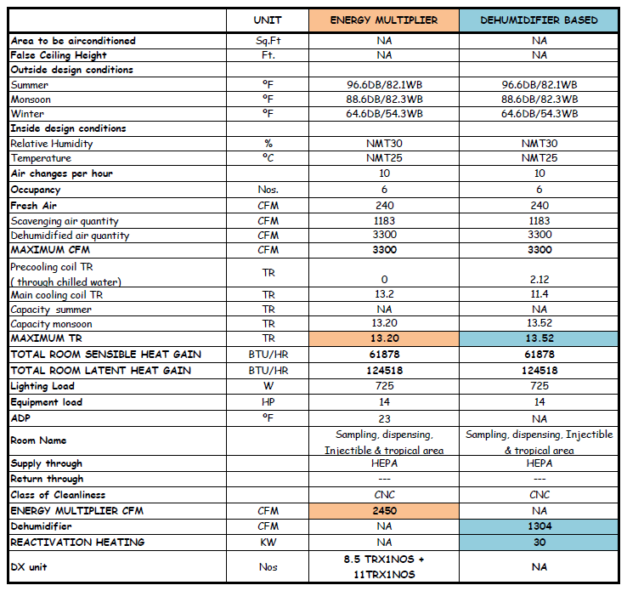
BASIS OF DESIGN

Slide 17
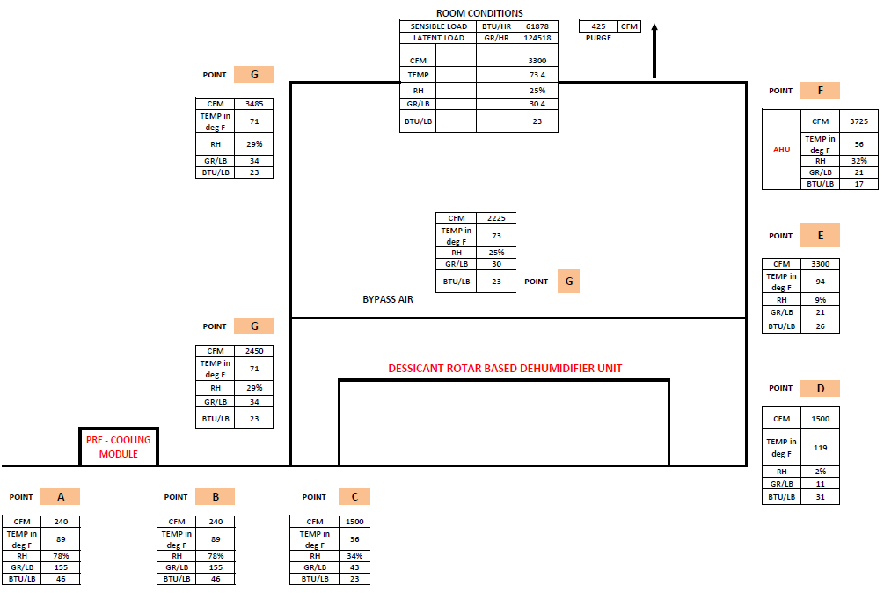
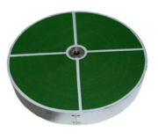
SCHEMATIC AIRFLOW DIAGRAM FOR DESSICANT WHEEL DEHUMIDIFIER
Total Utility Required
1 | Total TR | 13.5
2 | Reheat KW | 30

Slide 18
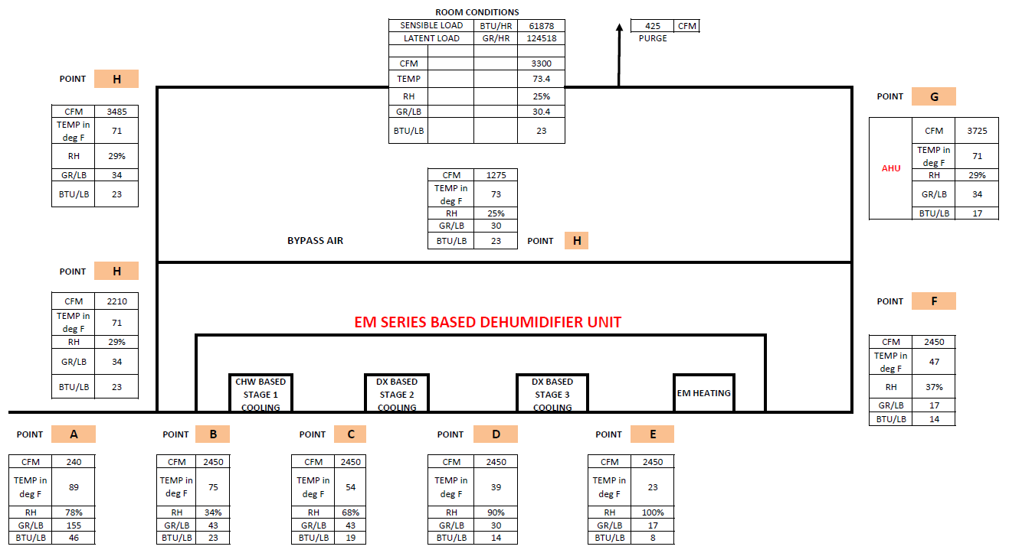
SCHEMATIC AIRFLOW DIAGRAM FOR EM SERIES DEHUMIDIFIER
Total Utility Required
1 | Total TR | 13.2
2 | Reheat KW | 0

Slide 19
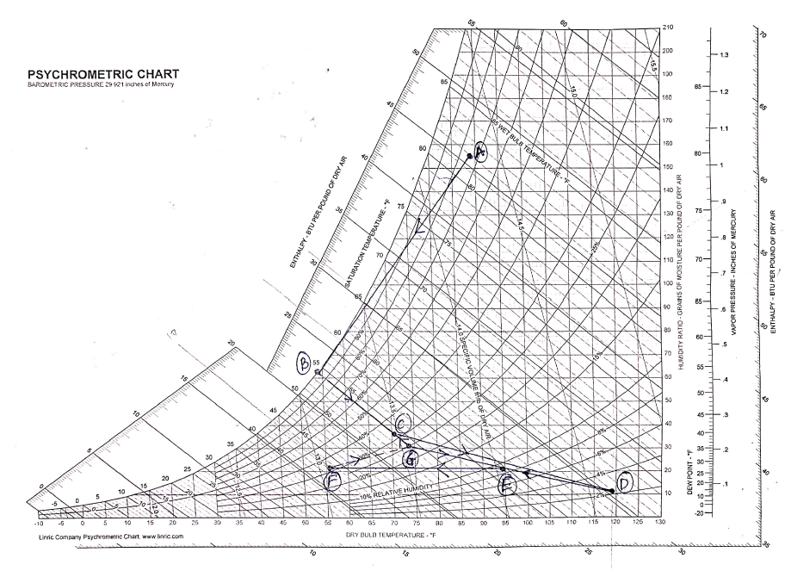
PSYCHOMETRIC CHART FOR DESSICANT WHEEL DEHUMIDIFIER

Slide 20
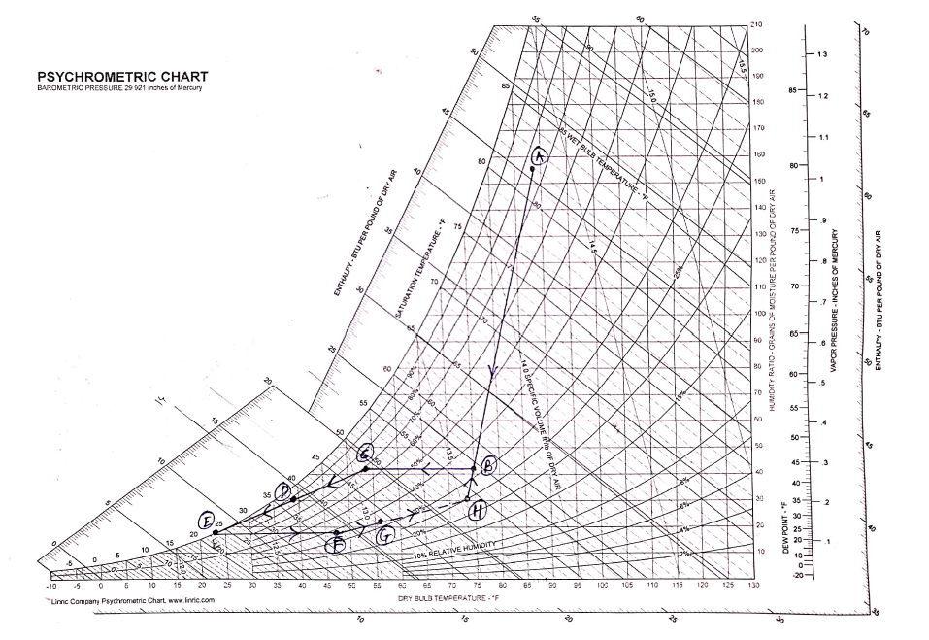
PSYCHOMETRIC CHART FOR EM SERIES DEHUMIDIFIER

Slide 21
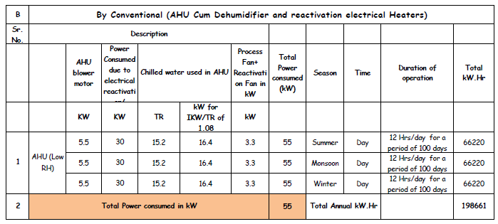
POWER COMSUMPTION

Slide 22
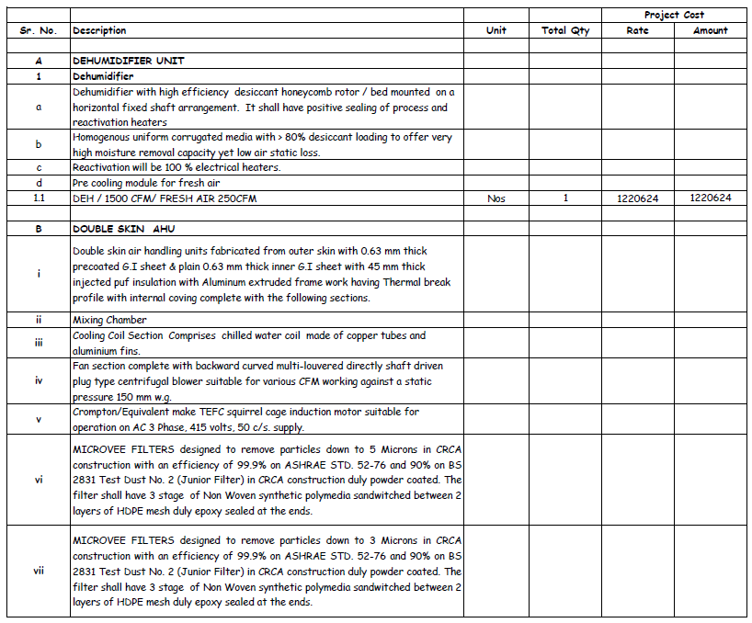
Cost of Dessicant rotar based Dehumidifier with AHU

Slide 23
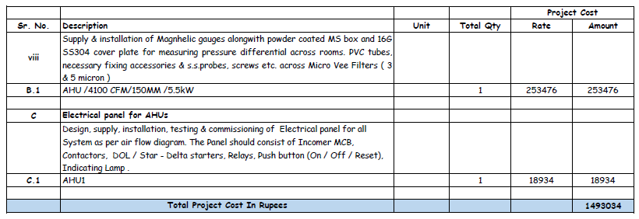

Slide 24
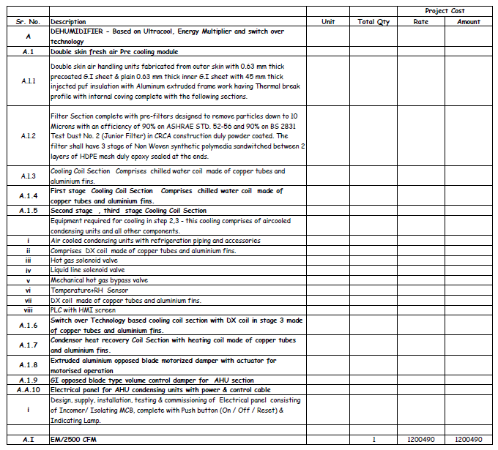
Cost of EM series based Dehumidifier with AHU

Slide 25
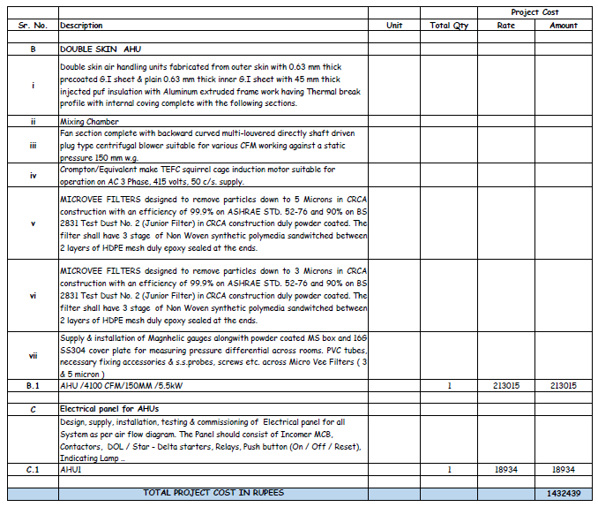

Slide 26
PAYBACK PERIOD ANALYSIS

